Slide 1

AI SELF DRIVING CAR Under the guidance of Prof. Merin Meleet and Anisha B S
Centre of competence
In
Visual Computing
Internship phase I presentation
Centre of competence
In
Visual Computing
Internship phase I presentation
Team Members:
Vishweshwar bhat
Ram Abhinav

Slide 2
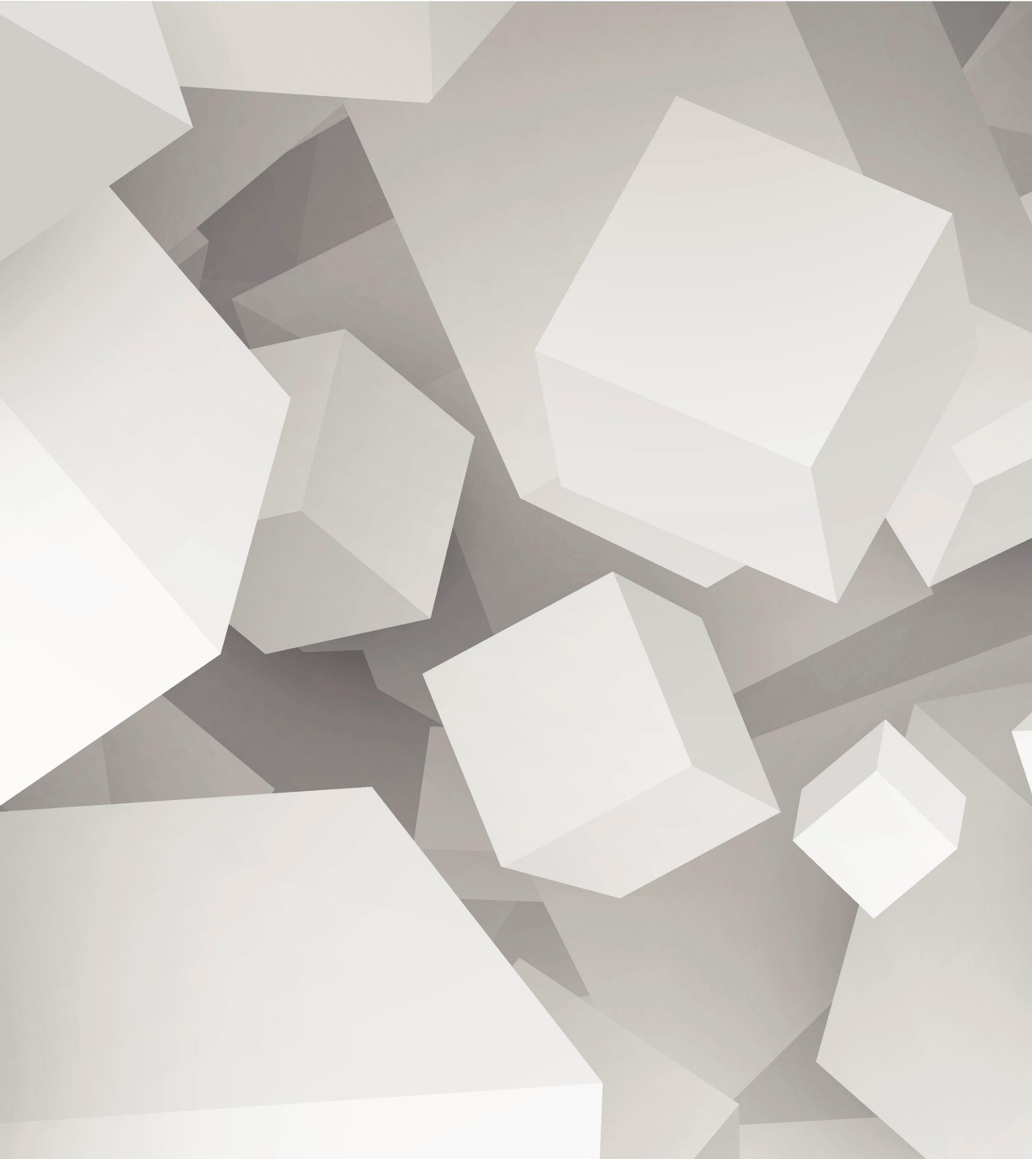

Contents
Introduction
Behavior cloning
Literature review
Research gap
Objectives
References

Slide 3
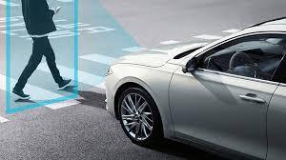
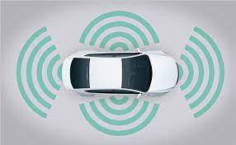
Introduction
Self Driving Cars are very common these days. With various tech. giants working in this field of research, autonomous mobility i.e. self-driving cars are no longer the talks of fiction. Various driving support systems are now available in market like lane assist, parking assist, etc. These features are called ADAS or Advanced Driver Assistance Systems. The cameras mounted on the front of the car i.e. on the hood of the car, are being used by various self-driving car engineers to implement these ADAS functions. Some functions include Road lane recognition, traffic signs detection, object or vehicle detection, and so on. The list is never ending. In this , various front facing cameras (center, left and right) are used to improve the driving behaviour of the self-driving cars and the model is trained in such a way that the car never goes out of the track despite of the road curvatures or sharp turns.

Slide 4
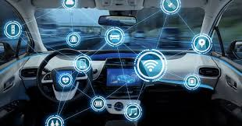
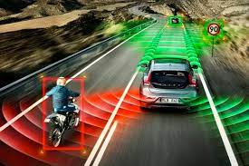
Car Behavior Cloning
Behavioral cloning is the process of replicating human behavior via visuomotor policies by means of machine learning algorithms. In recent years, several deep learning-based behavioral cloning approaches have been developed in the context of self-driving cars specifically based on the concept of transfer learning
The the goal of behavioral cloning is to collect data while exhibiting good behavior and then train a model to mimic that behavior with the collected data. While in a real-world setting this would involved mounting sensors on a car and driving around, in a simulator it looks more like this:

Slide 5
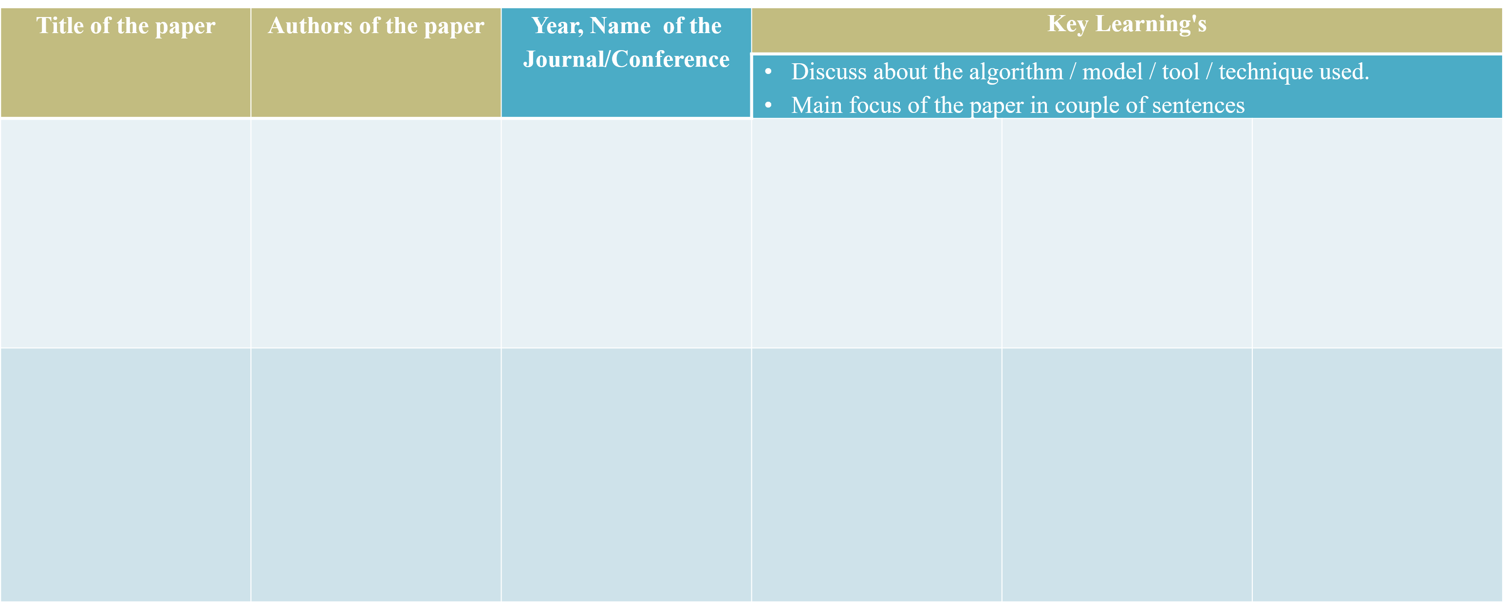
Literature Review
Behavior Cloning for Autonomous Driving using Convolutional Neural Networks
Wael Farag,
Zakaria Saleh
2018 International Conference on Innovation and Intelligence for Informatics, Computing, and Technologies (3ICT)
In this paper, they used Convolutional
Neural Network (CNN) to learn safe driving behavior and smooth steering maneuvering as an empowerment of autonomous driving technologies. The training data is collected from a front-facing camera and the steering commands issued by an experienced driver driving in traffic as well as urban roads. This data is then used to train the proposed CNN to facilitate what we call it behavioral cloning. The proposed Behavior Cloning CNN is named as “BCNet” and its deep seventeen-layer architecture has been selected after extensive trials. The BCNet got trained using Adam’s optimization algorithm as a variant of the Scholastic Gradient Descent (SGD) technique.. The proposed approach proved successful in cloning the driving behavior embedded in the training data set after extensive simulations.

Slide 6
Literature Review
Autonomous car using CNN deep learning algorithm
Sonata
Y Heryadi
L Lukas
A Wibowo
Annual Conference on Science and Technology (ANCOSET 2020)
This paper will discuss the use of CNN deep learning algorithm for recognizing the surrounding environment in creating the automatic navigation required by autonomous cars. The system designed will create and learn the data set that will be taken in advance and the learning outcomes will be implemented in an open simulation system.
Model architecture is same as NVIDIAs architecture

Slide 7
Literature Review
Convolutional Neural Network Computation for Steering Angle Prediction Based on Road Direction
Aires Da Conceicao , Dr. Shashang Degadwala
2020,
International Journal of Scientific Research in Science, Engineering and Technology
In this article they used CNN to predict the steering angle and also used Hough Transform, Panning and the CNN architecture is same as NVIDIA architecture

Slide 8
Literature Review
Effect of Various Activation Function on Steering Angle Prediction in CNN based Autonomous Vehicle System
Rounak Hazra, Aman Kumar, B. Baranidharan
December, 2019
International Journal of Engineering and Advanced Technology
This paper presents in detail literature survey on various techniques that have been used in predicting steering angle and object detection in self driving car. Apart from that, the effect of activation functions like ReLU, Sigmoid and ELU over the CNN model is analysed

Slide 9
Literature Review
End to End Learning for Self-Driving Cars
Mariusz Bojarski,
Davide Del Testa, Daniel Dworakowski
arXiv:1604.07316v1 [cs.CV] 25 Apr 2016
trained a convolutional neural network (CNN) to map raw pixels from a single front-facing camera directly to steering commands. This end-to-end approach proved surprisingly powerful. The network consists of 9 layers, including a normalization layer, 5 convolutional layers and 3 fully connected layers. The input image is split into YUV planes and passed to the network

Slide 10
OBJECTIVES
Data collection Using Simulator
Preprocessing and Augmentation
Building CNN
Hyperparameter tuning
Building Imagenet models
Saving The Best Model
Deploying the model on Simulator

Slide 11
References
[1] M. Bojarski, D. Del Testa, D. Dworakowski, B. Firner,
B. Flepp, P. Goyal, L. D. Jackel, M. Monfort, U. Muller,
J. Zhang, et al. End to end learning for self-driving cars.
arXiv preprint arXiv:1604.07316, 2016.
[2] M. Bojarski, P. Yeres, A. Choromanska, K. Choromanski,
B. Firner, L. Jackel, and U. Muller. Explaining how a deep
neural network trained with end-to-end learning steers a car.
arXiv preprint arXiv:1704.07911, 2017.
[3] Y. Wiseman and I. Grinberg, "When an Inescapable Accident of Autonomous Vehicles is
Looming", International Journal of Control and Automation, Vol. 9(6), pp. 297-308, 2016.
[4] C. Farabet, C. Couprie, L. Najman, and Y. LeCun. Learning
hierarchical features for scene labeling. IEEE transactions
on pattern analysis and machine intelligence, 35(8):1915–
1929, 2013.
[5] I. Sonata, Ilvico & Heryadi, Y & Lukas, L & Wibowo, A. (2021). Autonomous car using CNN deep learning algorithm
Autonomous car using CNN deep learning algorithm. Journal of Physics: Conference Series. 1869. 10.1088/1742-6596/1869/1/012071.
[6] Farag, Wael & Saleh, Zakaria. (2018). Behavior Cloning for Autonomous Driving using Convolutional Neural Networks.
1-7. 10.1109/3ICT.2018.8855753.

